Slide 1
De novo metagenomics assembly
Christopher Quince
Warwick Medical School

Slide 2
Overview
Current state of sequencing technologies
De novo assembly paradigms
Coverage
Repeats
Metagenomics assembly
Binning
Thames metagenome database

Slide 3
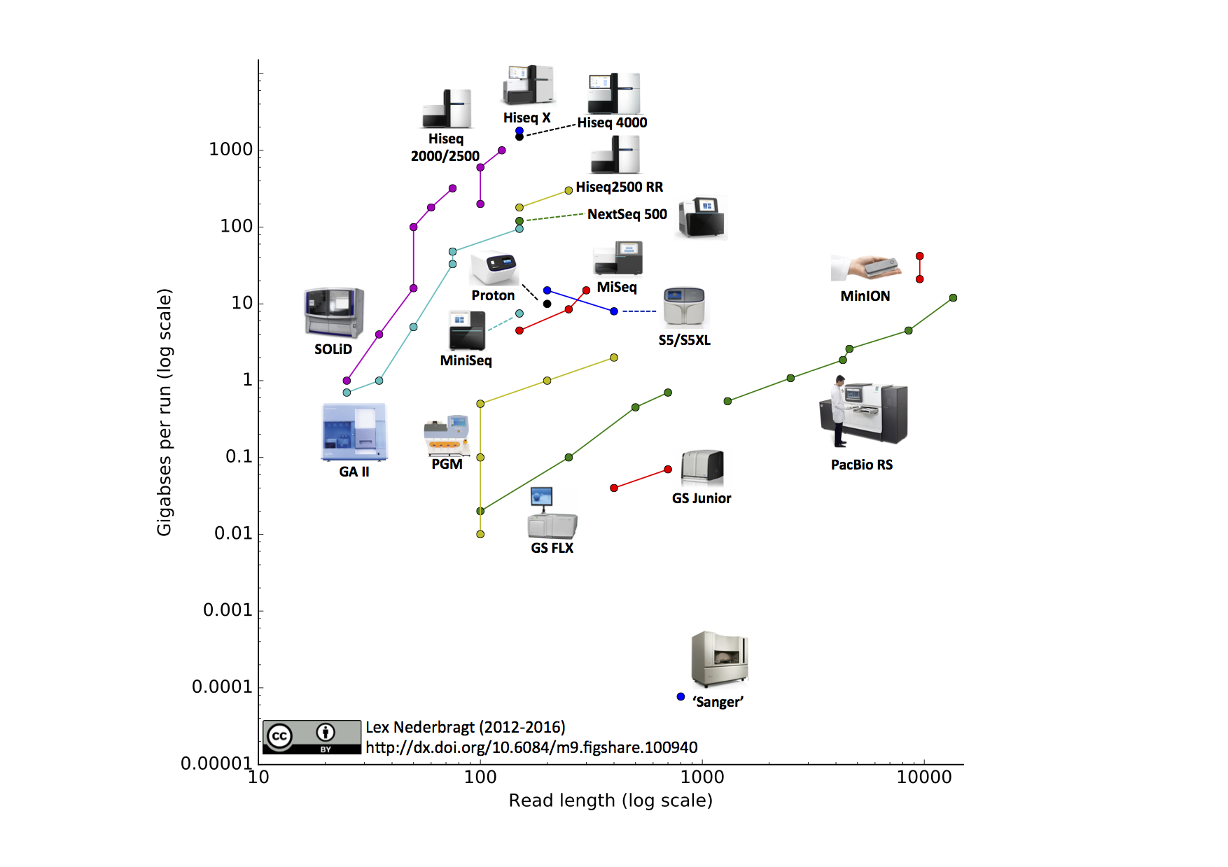
Lex Nederbragt
https://figshare.com/articles/developments_in_NGS/100940

Slide 4
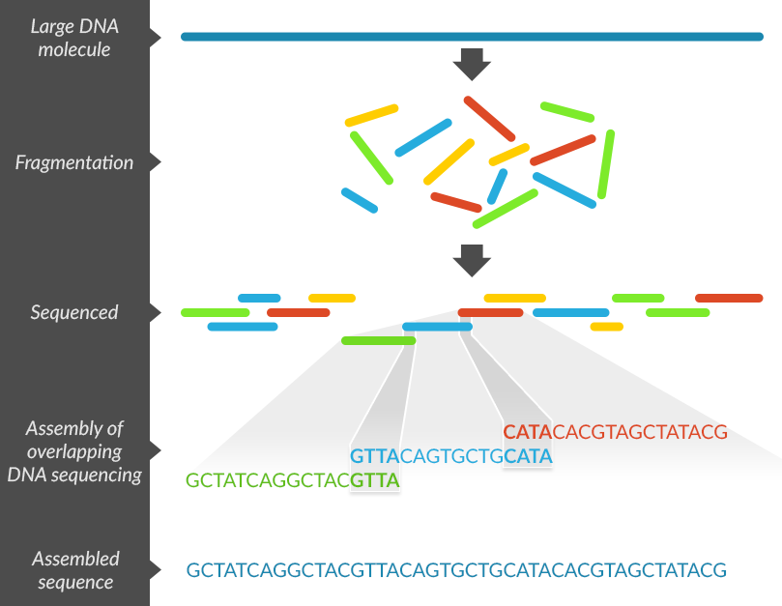
What is de novo sequence assembly?

Slide 5
Overlap layout consensus
OLC slow because of pair-wise comparisons
Renaissance with long read technologies
Genetic variation and the de novo assembly of human genomes
Mark J. P. Chaisson, Richard K. Wilson & Evan E. Eichler
Nature Reviews Genetics 16, 627–640 (2015) doi:10.1038/nrg3933

Slide 6
De Bruijn graph assembly
Fast but effectively fixed length exact overlaps
Still default for short read next generation

Slide 7
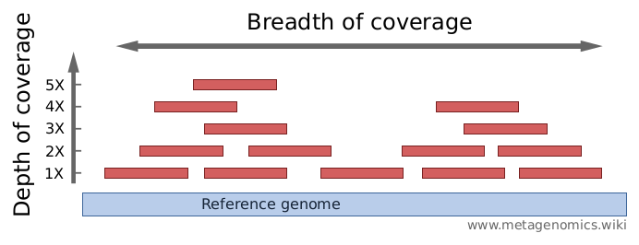
Coverage depth of taxa n
Where ρ_{n} is genome relative frequency of taxa n
R number of reads in library
L read length
G_{n} is genome length of taxa n

Slide 8
Lander-Waterman statistics
Assume reads randomly distributed across genome
Fraction of genome covered:
Mean number of contigs:

Slide 9
Gaps in assembly
A contig is just an unambiguously assembled genome fragment
What is the optimal kmer length for de Bruijn graph assembly?

Slide 10
Genome assembly in practice
Read errors generate tips that are pruned:

Slide 11
Genome assembly in practice
Read errors generate tips that are pruned:

Slide 12
Bubbles
Errors can also generate bubbles but these can also be real variants
These are popped
Removing real variants from assembly

Slide 13
Contigs
Remove ambiguous edges output linear portions of graph:

Slide 14
Variable k-mer length dBG assemblers
Small k more branches
Larger k more gaps
Approach pioneered in IDBA is to iterate through kmer lengths to get best of both
Used in most dBG assemblers now: idba, idba_ud, megahit, minia

Slide 15
Evaluating assemblies
Total size of assembly
Number of contigs
N50 – minimum contig length in which at least 50% of bases are contained
But contigs can be chimeric (Quast)

Slide 16
Why is metagenomics assembly hard?
Took five Lactococcus paracasei temperate phage genomes: CL1, CL2, iLp84, iLp1308, and iA2
The genome lengths ranged from 34,155 bp (iA2) to 39,474 bp (CL1)
Generated 10,000 synthetic 2X150bp reads for 16 samples
Mercanti et al. Genomic Diversity of Phages Infecting Probiotic Strains of Lactobacillus paracasei
AEM 2016

Slide 17
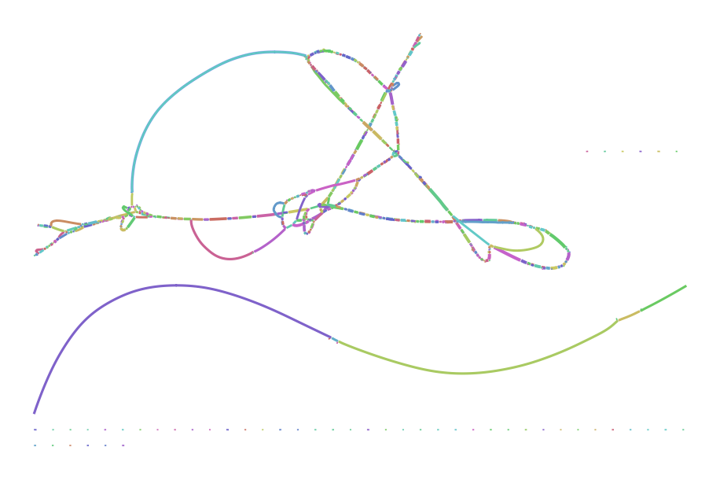
De Bruijn graph Bcalm assembly with kmer length 71

Slide 18
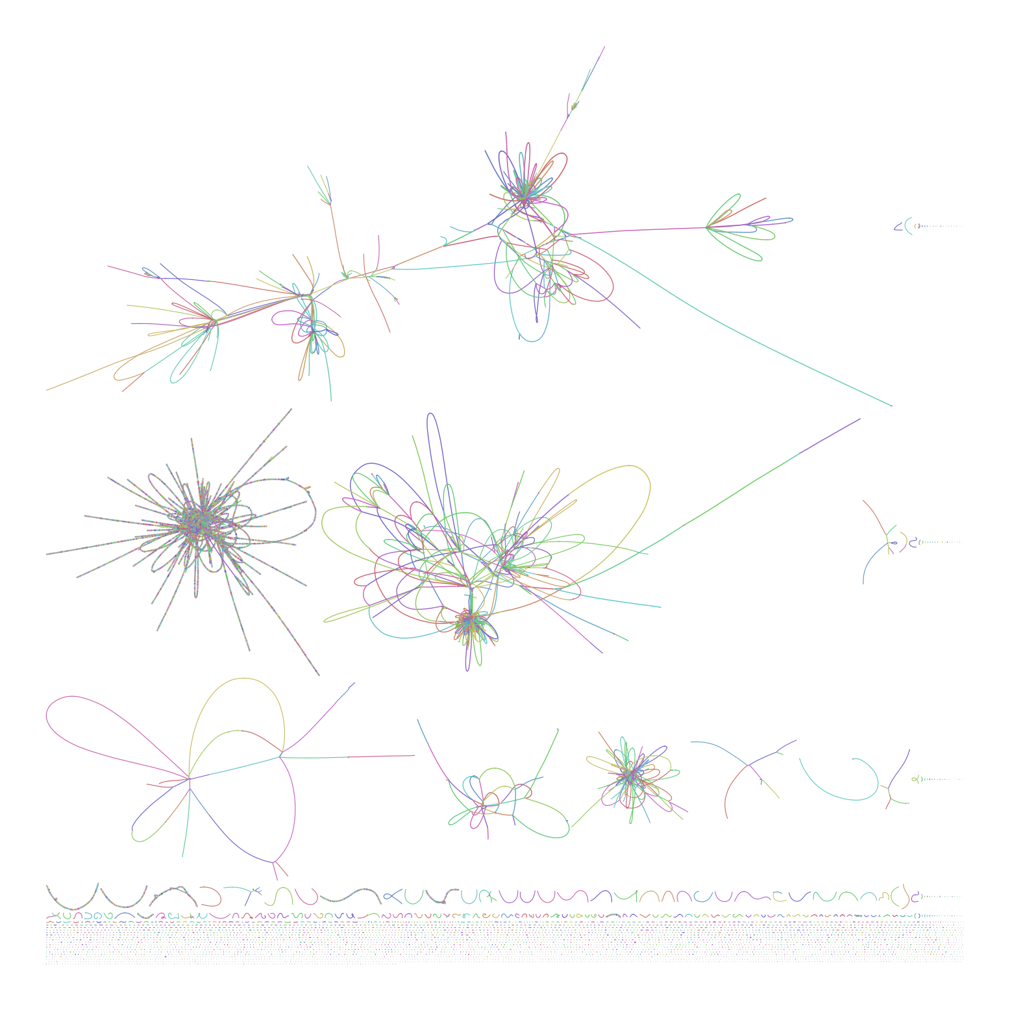
20 bacterial genomes?
Use contig binning to cluster contigs back into strain/species genomes

Slide 19
Coassembly
In a metagenome study we may have multiple studies from similar environments with the same organisms:
Time series e.g. reactor
Horizontal sampling
Combining samples increases coverage of rare organisms and enables binning
Cost is increased strain confusion
Are contigs useful?

Slide 20
Can look at context in contig e.g. AMR
Example k91_4988077 9 genes 1 ABR hits
>PROKKA_00001 Beta-lactamase
>PROKKA_00002 hypothetical protein
>PROKKA_00003 hypothetical protein
>PROKKA_00004 hypothetical protein
>PROKKA_00005 hypothetical protein
>PROKKA_00006 L-Ala-D/L-Glu epimerase
>PROKKA_00007 HTH-type transcriptional regulator MurR
>PROKKA_00008 Penicillin-binding protein 4*
>PROKKA_00009 hypothetical protein
Top blast hit Lysobacter antibioticus strain ATCC 29479 genome 78% 75%

Slide 21
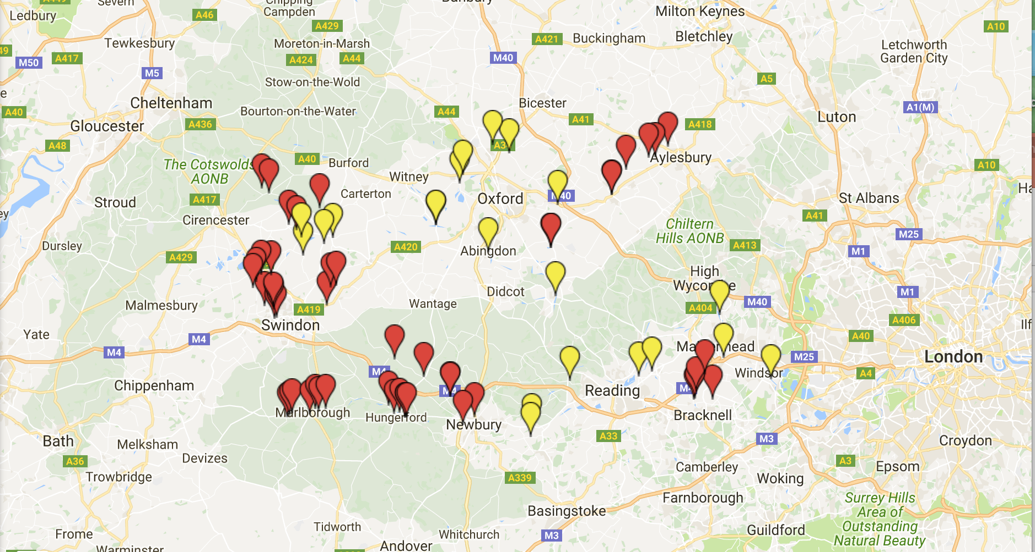
Thames AMRG survey
69 sites located along 7 tributaries of Thames catchment were chosen for sampling across three seasons
Sampling begins at the source of each tributary and continues along the tributary where potential sources of AMR (eg. WWTPs and fish farms) are located.
DNA was purified from triplicate samples and qPCR was used to determine resistance loads at each site.
16S rDNA amplicon sequencing on all sites
Water quality, nutrients and antibiotic residues
Shotgun metagenomes
qPCR Targets
Gene Target | Resistance to/Marker
16S rDNA | bacterial marker
IntI1 | class 1 integron
QacE | quaternary ammonium compounds
TetM RuBac HuBac | Tetracycline Ruminant assoc. Bacteroides Human assoc. Bacteroides
QnrS | fluoroquinolones
ErmF | erythromycin (macrolide)
CTX-M (Group 1) | CTX-M-1 and 15 (beta lactams)
E. coli | faecal contamination
Enterococci | faecal contamination
Routinely monitored by CEH
Extra sites chosen for study

Slide 22
Performed assemblies with megahit

Slide 23
Annotation of ABR genes
Called 67,367,045 ORFs on contigs
Annotate using CARD database
Chose 33% amino acid identity
Gave 122,936 potential AMRGs i.e. 0.18%
CARD provides hierarchical ontology, we focus on simplified classification e.g.:
Gene id | Mechanism | Gene name | Target
ARO:3001811 | antibiotic inactivation | OXA beta-lactamase | penam,cephalosporin

Slide 24
Drug class
Look at changes in abundance of class with seasons, tributary, antibiotic residues WWTP etc.

Slide 25
Variation across tributary:

Slide 29
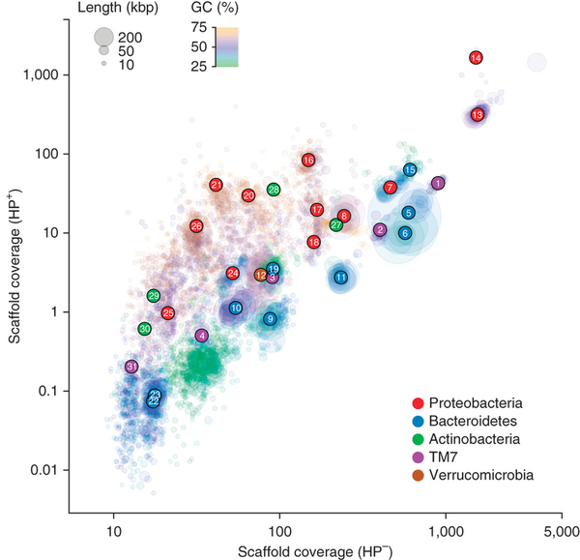
Contig clustering
Use shared features across contigs to cluster into metagenome assembled genomes or MAGs:
Composition – tetramer frequencies
Coverage across multiple samples
Algorithms:
Human input e.g. ESOM and ANVIO (Meren et al. PeerJ 2015)
Automatic e.g. CONCOCT (Alneberg et al. Nat. Methods 2014), MetaBAT (Kang et al. PeerJ 2015), MaxBin2 (Wu et al. Bioinf. 2015)
Albertsen et al” Nature Biotech. 2014

Slide 30
Took coassembly and ran CONCOCT with 2000bp cutoff
6008 clusters of which 614 were 75% pure and complete MAGs
Construct tree from 36 core genes and ~1700 reference genomes

Slide 32
Planctomycetes
Archaea
Interesting things:
One Commamox
Lots of CPR

Slide 33
Archaea metabolism
Clade of low salinity AOA
Candidatus
Nitrosoarchaeum
Methanobacterium
Methanosarcina
Nitrogen fixation
Nitrification
Autotrophic methanogenesis

Slide 35
Bacteroidetes clade

Slide 37
Summary
De novo assembly of genomes is a powerful way to extract biological information from data set
We will end up with very fragmented assemblies
These are still useful and can be made even more useful with binning

